Slide 1
TLDU06 - Occupational Specialist Component Content: Digital Production, Design and Development
The T Level T Level Technical Qualification in Digital: Digital Production, Design and Development includes a single Occupational Specialist Component. Therefore, there is a single synoptic assessment for the Occupational Specialist Component, which is an extended ‘design, development and implementation’ project. The synoptic element of the project is important in order to ensure that students are able to demonstrate threshold competence: this is the principal reason why the Occupational Specialism is assessed via a single extended project assessment to ensure that students are able to evidence all the skills required by the Performance Outcomes.
The T Level Technical Qualification in Digital: Digital Production, Design and Development Occupational Specialist Component consists of several activities grouped into four substantive tasks.
Each task will be completed during a window set by Pearson during which you will schedule supervised assessment sessions. In some cases, tasks will also involve opportunities for unsupervised activities where the requirements of the skills being assessed make this necessary.

Slide 2
Learning Objectives
Aims:
To investigate the legal and regulatory requirements that apply to developing software.
Objectives:
To understand legal and regulatory requirements that apply to developing software.
To understand the ethical implications that apply to software development
Notes:
intellectual property rights and licenses
● consumer protection
● age ratings and classifications
● advertising laws
● data protection and privacy
● copyright and patent
● gambling legislation
● responsibilities concerning staff and employment practices
● territorial restrictions
● system security
● equality and diversity
● investigate and apply standards for software development
● ISO/IEC/IEEE 90003:2018
● W3C.
Investigate and consider ethical implications that apply to software development:
● code of conduct
● professional practice
● software licensing
● inclusion and diversity.

Slide 3

Intellectual Property Rights and Licenses
Legal rights that protect creators of original software, designs, and inventions.
Intent: To ensure developers and organizations can protect and monetize their creations while respecting the rights of others.
Key Features:
Copyright protects source code and creative elements
Patents protect inventions (e.g., unique algorithms)
Licenses (GPL, MIT, Apache) dictate how software can be used, modified, and distributed
Notes:
https://www.burges-salmon.com/news-and-insight/legal-updates/a-guide-to-intellectual-property-rights-in-the-uk
The main types of intellectual property (IP) rights in the UK are:
Trade marks, both registered and unregistered
Patents
Designs, both registered and unregistered
Copyright
Trade secrets.
If you are launching a business in the UK, you may well want to consider some or all of these (at least to replicate the protection you have in other territories). Please note that, with effect from the end of the Brexit ‘transition period’ on 31 December 2020, EU-wide rights no longer give protection in the UK and the UK will not be deemed to form part of any relevant EU-wide regime. As noted below, this has particular implications for the UK’s trade mark and registered/unregistered designs regimes.
rade marks
Unregistered rights: In the UK, unregistered rights in a brand may be created through use of that brand over time, as goodwill is built in it: this may enable the owner to bring a passing off action to prevent third parties from using an identical or highly similar brand. However, there are disadvantages to relying on this approach – not least its uncertainty and the heavier burden of proof.
Registered rights: If you are launching in the UK, it is strongly preferable to register your brands as trade marks. This creates both an asset and a clearer right to enforce.
Territory: Trade mark protection is territorial, so that applications need to be filed in each country or territory of interest to a business. This means that even if a company has trade mark registrations elsewhere, e.g. Japan or the USA, these rights will not automatically extend to the UK.
Options: In the UK, there are currently two ways of obtaining registered trade mark:
a UK national trade mark application; and
an international trade mark application designating the UK or EUTM.
Please note, Brexit has changed the position vis-à-vis obtaining trade marks in the UK, most notably in respect of EU trade marks (EUTMs). All EUTMs registered prior to 1 January 2021 were automatically ‘cloned’ and recorded as new (and distinct) marks on the UK trade mark register (a ‘comparable UK trade mark’). These new comparable UK marks retained the EUTM filing, priority and/or UK seniority dates associated with the underlying EUTM. In contrast, however, any EUTM applications pending as at 1 January 2021 (and therefore registered after 1 January 2021) were not subject to this cloning process. Owners of any such marks will have a nine-month period within which to register a comparable UK trade mark. Successful applications submitted within this period will retain the same filing, priority and/or UK seniority dates as the original EUTM.
We are happy to advise further on any of these points, including the impact of Brexit.
Clearance Searches: Even if a brand is well established in another territory, it is strongly recommended to conduct clearance searches in the UK before launching or filing a new trade mark application here, to see if there are any earlier trade mark right holders that may object to the application or that you could be infringing by using your brand.
Classes: When you apply to register a trade mark in the UK you have to specify the goods and services that you intend to use the brand for. These are organised into 45 different classes under the Nice classification system. Official trade mark application fees are charged on a per class basis. The UK Intellectual Property Office (IPO) accepts a broader list of goods and services than certain territories, such as the USA, so it is recommended to seek UK counsel input into a trade mark specification even if one has already been prepared and filed in another territory.
Application process: Once a UK application has been filed it will be examined by the UK IPO to ensure that it complies with various registration requirements. The IPO will also conduct a search of the IPO Register for earlier rights they consider to be similar to the mark applied for – the application will not be refused on this basis, but earlier right holders will be notified of the application and it will be for them to take action if they consider there to be a conflict. Assuming there are no major issues during examination, the application will be published for opposition purposes. If no oppositions are filed by third parties the application will proceed to registration and a certificate will be issued. For a straightforward application this process typically takes around four to six months.
Duration of Registration: UK registrations can be renewed every 10 years, for a fee, and can last indefinitely so long as they are used and renewed.
Priority: Once an initial trade mark application has been filed in (almost) any territory the filing date may be preserved for additional applications abroad provided those application are filed within six months. This ability to back-date later applications is known as 'claiming priority' and is useful as it allows time to see how the first application progresses before any investment is made in additional territories, as well as helping to stagger costs. The UK IPO accepts priority claims from earlier applications/registrations, and UK applications can be used as priority applications. Later applications can be made after the end of this priority period, but those later applications will simply be dated at the date of the application.
Marking: The trade mark registration symbol ® must only be used in the UK after a valid UK registration has been obtained. The TM symbol can be used to indicate a trade mark before an application is filed or while it is pending. This applies to use on products or packaging, as well as on a website directed at the UK. See further guidance note on e-commerce.
Other registrations: In the UK, neither simply registering your company name at Companies House nor owning the domain name for your website gives you rights to prevent others using your trade mark. Therefore, it is important that specific consideration of IP protection is given when launching in the UK.
Patents
What is protected? Patents can protect inventions which are not yet in the public domain. It is important to keep inventions secret and disclose them only under a Non-Disclosure Agreement in order to preserve the ability to patent them.
Requirements to be registered: Requirements for protection include that the invention is new, something that can be made or used, and not just a foreseeable modification to something already out there. The invention should not be made public before patent protection is sought (and, as set out below, an earlier application in a different country can be publication that prevents a later registration in the UK).
Territorial: Like trade mark protection, patent protection is territorial – so protection in one territory will not protect in another.
Infringement: You should undertake freedom to operate searches before launching an invention in the UK. This is the case even if you have already launched elsewhere (or you already have a patent registered elsewhere), as there may be different patents in the UK which are infringed by your invention.
Timing: Unlike trade mark protection, there is a limited period of time in which to select the countries in which you want to file a patent application. So, if you already have a patent in one territory, it may no longer be open to you to protect the same invention in the UK. Bespoke advice may be required here.
UK Patents: Patents can be registered through the UK IPO (which may be accessed through a European Patent Application (via the European Patent Office) or through an International Patent Application (via the World Intellectual Property Office). Once registered, patents can be renewed (on payment of renewal fees) for up to 20 years.
Designs
What is protected? Designs can protect the appearance, shape, configuration or decoration of the whole or part of a product. Requirements for protection include that the design is new, and creates a different overall impression to any earlier design already in the market. The design should not be made public before registration is sought.
Unregistered rights: Unregistered UK 'Design Rights' will arise automatically to protect certain shape and configuration (3D) designs. However, Design Rights provide less protection than Registered Designs and are of shorter duration (for the earlier of 10 years after it was first sold or 15 years after it was created). There are also EU Design Rights (Unregistered Community Designs (UCD)), which are of shorter duration again. UCDs existing before 1 January 2021 automatically retain UK protection as a continuing unregistered design, with protection continuing for the remainder of the three year term that attached to the UCD.
Registered Designs: Designs can be registered through the UK IPO. Before launching or applying to register a design it is advisable to conduct a clearance search. Once registered, designs can be renewed (on payment of renewal fees) every five years for up to 25 years. Since 1 January 2021, EU registered designs (Registered Community Designs (RCDs)) are no longer valid in the UK. Any RCD that existed prior to this date was automatically cloned to allow for comparable UK rights. The comparable right is a fully independent UK registered design capable of being assigned, renewed or challenged separately from the original RCD. By contrast, a comparable UK right was not created for any RCD application that was pending (i.e. not yet registered as an RCD) on 1 January 2021. Applicants in this position have a nine-month period (starting on 1 January 2021) within which they can apply for a comparable UK design right with the same filing, priority and/or UK seniority dates as their original RCD application.
Copyright
What is protected? Copyright can protect original literary, dramatic, musical and artistic work, as well as software and databases and audio/visual recordings.
Unregistered rights: Unlike trade marks, designs and patents, copyright in the UK cannot currently be registered (so there is no central register and no fee requirement). Copyright arises automatically in the UK as soon as certain requirements are met, including the need for the work to be written down or recorded.
Marking: It is best practice to mark original work with the copyright symbol ©, the name of the author/creator, and the date of creation – not least so (recognising that there is no register) third parties are put on notice that the work is protected by copyright and can trace the copyright owner.
International protection: The UK has signed various copyright treaties which allow the UK to provide copyright protection in respect of copyright protected in other signatory countries. If you have copyright outside the UK, those treaties may operate to provide automatic protection in the UK too.
Trade secrets
Trade secrets can protect business information such as recipes and customer lists. There is not a specific register for this. In the UK these can be protected under the common law of confidence, through keeping the information secret and through only disclosing to those that have signed non-disclosure agreements.
Managing your intellectual property
Audit: You should regularly take stock of your IP assets. This is called an ‘IP Audit’ and it will help in ensuring your IP protection is up-to-date. Burges Salmon can work with you in conducting an IP Audit, and can advise on the scope and status of your current IP portfolio, how it compares to what IP you actually have and use, what further enforceable IP rights you might have, and the best way to protect and enforce those rights.
Licensing and transfer of IP rights: IP rights can be very valuable intangible property assets. The rights can be licensed, transferred, sold, or used to secure investment. For certain IP rights, such as trade marks, it is best practice to record any such licences or transfers on the IPO Register. Please contact the Burges Salmon IP and Commercial teams to discuss your requirements regarding dealing with your IP. See also our note on Contracting Under English Law.
Enforcement: You may also wish to use your IP to enforce your rights against others.

Slide 4
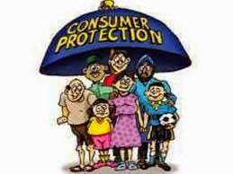
Consumer protection
Laws ensuring that users are treated fairly when purchasing and using software.
Intent: To prevent deceptive practices, ensure software quality, and guarantee access to redress if issues arise.
Key Features:
Clear terms and refund policies
Prevention of false claims
Obligation to deliver functioning, secure products
Notes:
https://www.legislation.gov.uk/ukpga/1987/43/contents
https://www.thecpa.co.uk/news/breaking-down-consumer-protection-act-1987/
KEY POINTS ABOUT THE CONSUMER PROTECTION ACT 1987
A claim can’t be brought if the damaged property is below £275 in value.
A claim can’t be brought for damage due to business products that are not ordinarily intended for personal use
The Act doesn’t just cover the consumer that purchased the faulty product. Anyone who suffers damage is entitled to a claim.
Consumers can begin court cases up to 3 years from the initial date of the injury
No claim can be submitted more than 10 years since the product was last sold
Should a product be declared faulty; the Act gives local authorities the right to seize unsafe goods and suspend retailers from selling them

Slide 5
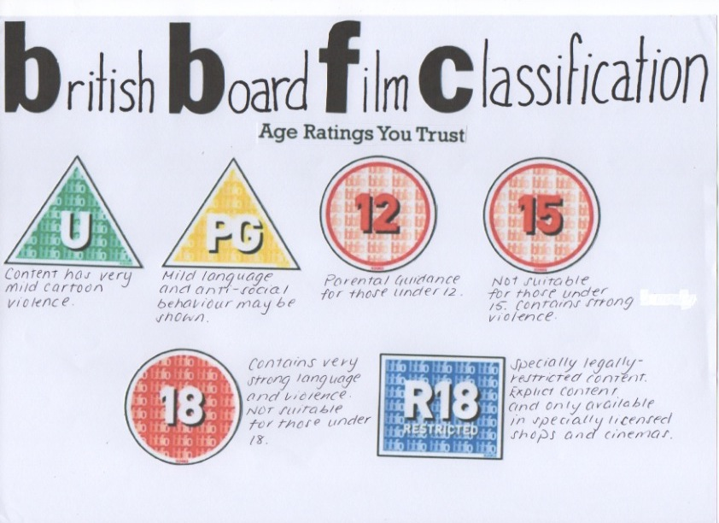
Age ratings and classifications
Regulations that assign age-appropriate ratings to digital products based on content.
Intent: To prevent children and young users from accessing unsuitable or harmful material.
Key Features:
PEGI, ESRB, and BBFC for games and media
Mandatory disclosure of violence, gambling, adult content
Integration with parental control systems
Notes:
Age ratings are systems used to ensure that entertainment content, such as games, but also films, tv shows or mobile apps, is clearly labelled with a minimum age recommendation based on the content they have.
Age and content ratings on apps and games (net-aware.org.uk)
New rules to better protect children from inappropriate video game content - GOV.UK (www.gov.uk)
Most apps will give their own ratings, but app stores, like Apple, Google and Amazon, have different ways of rating. There’s also the PEGI age rating system, which is used in a lot of European countries.

Slide 6
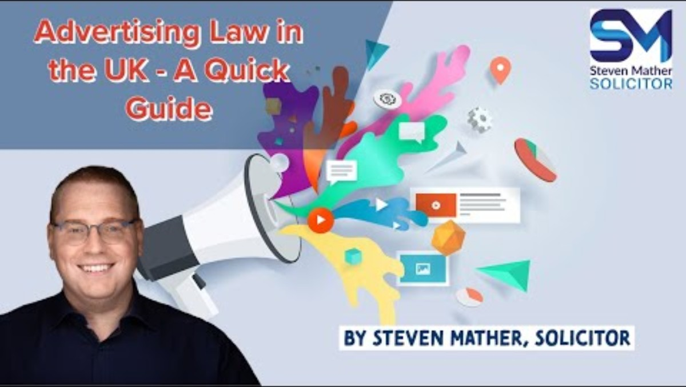
Advertising laws
Rules governing how software products are marketed and promoted.
Intent: To ensure advertisements are honest, legal, and not misleading, especially for vulnerable users.
Key Features:
Clear disclaimers and consent for in-app ads
Ban on deceptive performance claims
Rules for endorsements, data collection in ads
Notes:
Marketing and advertising: the law - GOV.UK (www.gov.uk)
Advertisers: a guide to advertising regulation in the UK (pinsentmasons.com)
How are advertising and marketing regulated in the UK? | marketinglaw (osborneclarke.com)

Slide 7
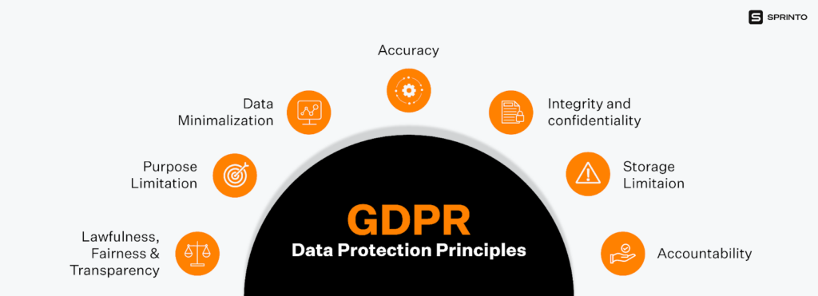
Data Protection and Privacy
Laws and policies that govern how personal data is collected, stored, and used.
Intent: To give users control over their personal data and ensure it’s handled securely.
Key Features:
GDPR, CCPA, and other data protection regulations
User consent, right to access/delete data
Data minimization and encryption

Slide 8

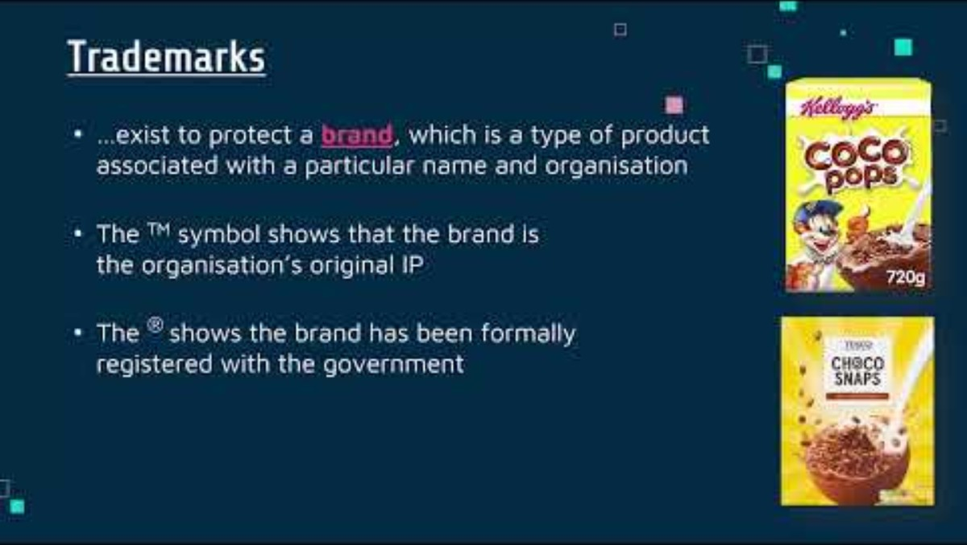
Copyright and Patents
Legal frameworks protecting original software works and inventions.
Intent: To incentivize innovation and ensure fair use of others' work.
Key Features:
Copyright for code, design, and media assets
Patents for technical innovations
Enforcement mechanisms for infringement

Slide 9
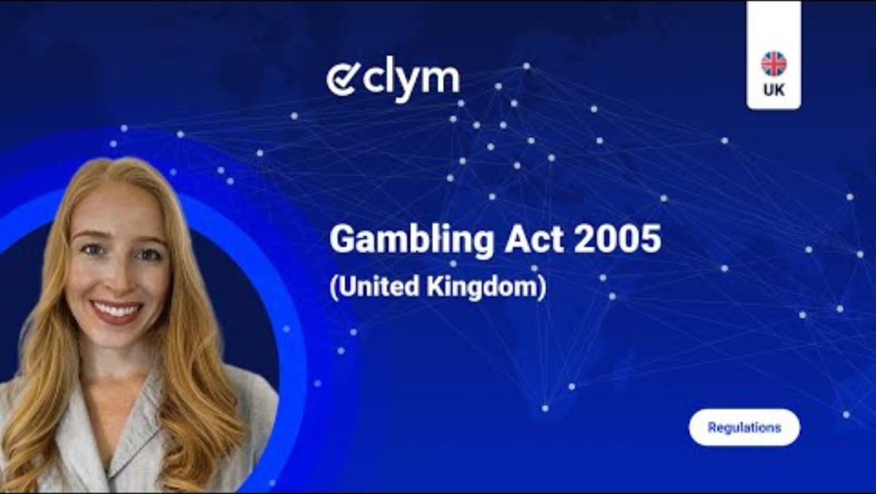
Gambling legislation
Laws regulating games or applications involving betting, chance, or monetary rewards.
Intent: To prevent exploitation, underage gambling, and ensure transparency.
Key Features:
Legal compliance for loot boxes and prize draws
Mandatory age verification
Regulatory approval in some jurisdictions
Notes:
Gambling Act 2005 (legislation.gov.uk)
Regulation in the software and gaming industries | nibusinessinfo.co.uk
https://www.legislation.gov.uk/ukpga/2005/19/contents

Slide 10
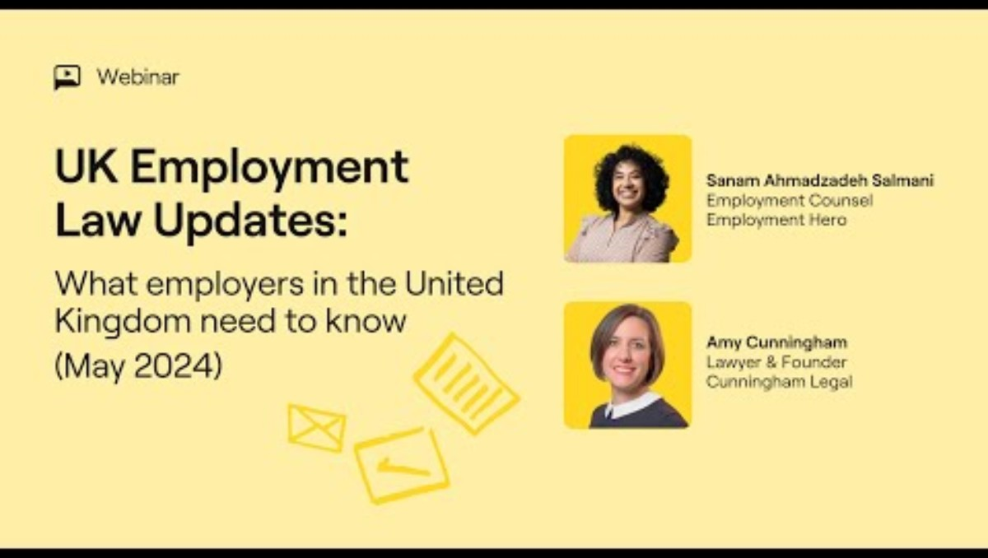
Responsibilities concerning staff and employment practices
Legal obligations around employment, workplace safety, and fair treatment.
Intent: To create safe, equitable, and legal working environments for software teams.
Key Features:
Employment contracts and IP ownership clauses
Health & safety, anti-harassment policies
Fair pay, diversity, and inclusion mandates
Notes:
26 Employees and Employers Rights and Responsibilities - WiseStep

Slide 11
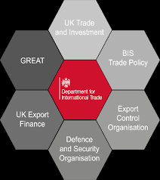
Territorial Restrictions
Regulations limiting where software or features can be legally distributed or accessed.
Intent: To comply with national laws and avoid legal risks in restricted markets.
Key Features:
Geofencing for restricted content
Regional compliance (e.g., encryption laws)
Export controls (e.g., U.S. regulations on software)
Notes:
https://www.gov.uk/guidance/export-controls-dual-use-items-software-and-technology-goods-for-torture-and-radioactive-sources
https://www.dpocentre.com/gdpr-advice-for-saas-companies-entering-eu-uk-markets/
https://incountry.com/blog/the-uk-data-sovereignty-framework-requirements-and-solutions/

Slide 12
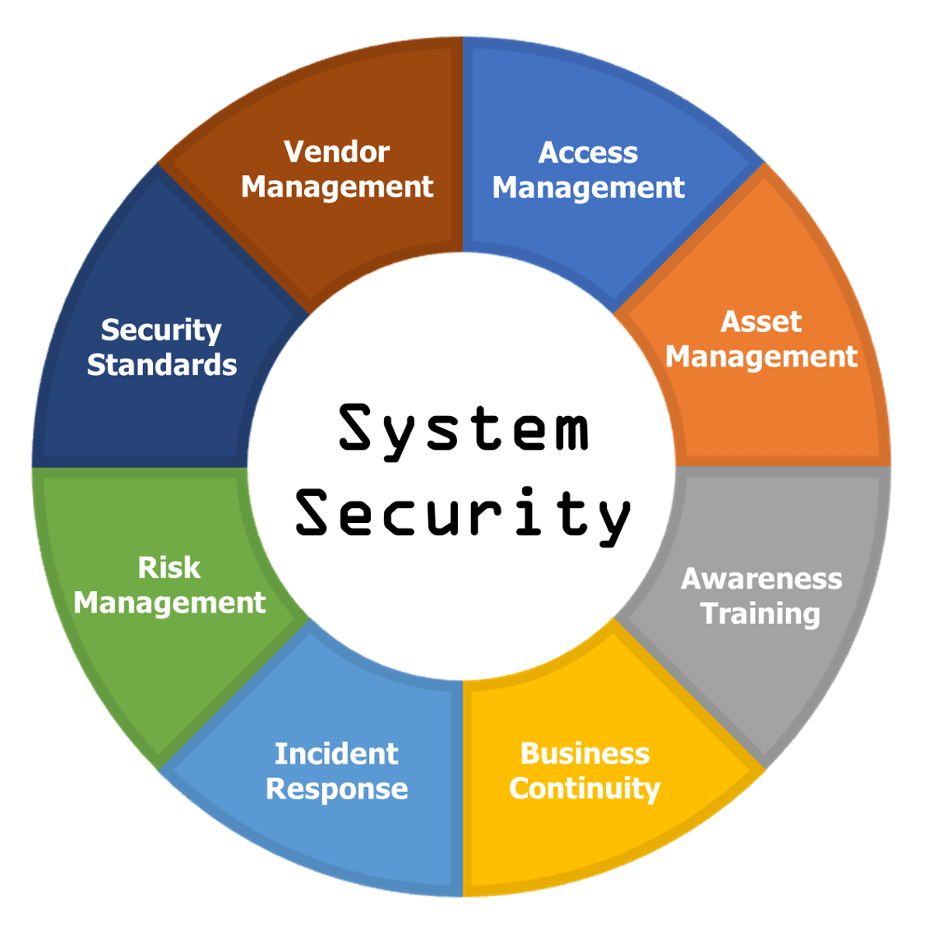
System Security
Laws and best practices around the secure design and maintenance of software systems.
Intent: To protect data, prevent breaches, and ensure resilience against cyber threats.
Key Features:
Secure development lifecycle (SDLC)
Regular patching and vulnerability assessments
Incident response planning
Notes:
https://my.infotex.com/four-basic-truths/

Slide 13
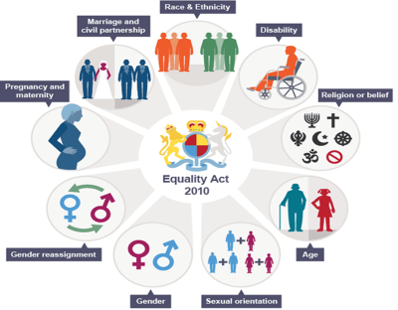
Equality and Diversity
Legal and ethical responsibilities to promote inclusive practices in software and the workplace.
Intent: To avoid discrimination and ensure access for all users and employees.
Key Features:
Accessibility standards (e.g., WCAG 2.1)
Anti-bias practices in AI and design
Inclusive recruitment and leadership
Notes:
https://cmsvoc.co.uk/blog/a-guide-to-equality-and-diversity/
https://www.bbc.co.uk/bitesize/guides/zdnjhbk/revision/2

Slide 14
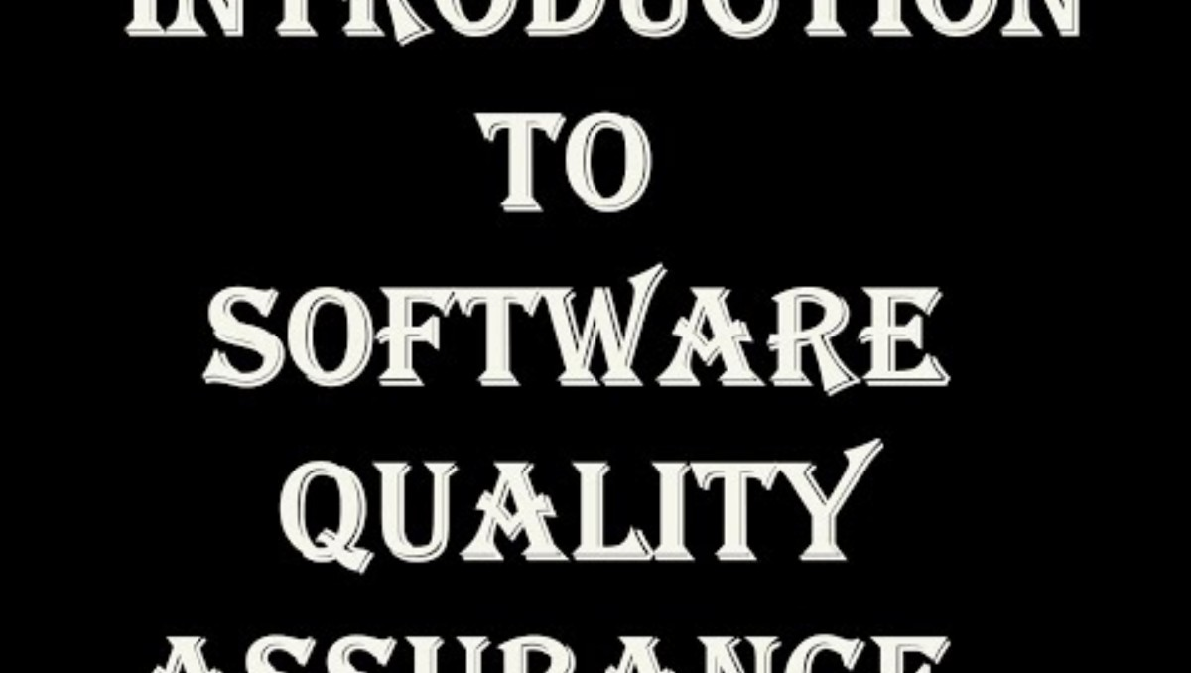
ISO/IEC/IEEE 90003:2018
International quality management guideline for applying ISO 9001 to software development.
Intent: To standardize quality assurance processes and improve development efficiency.
Key Features:
Emphasis on documentation, process control
Continuous improvement cycle
Risk-based approach to software quality
https://www.iso.org/standard/74348.html
Notes:
https://www.iso.org/standard/74348.html

Slide 15
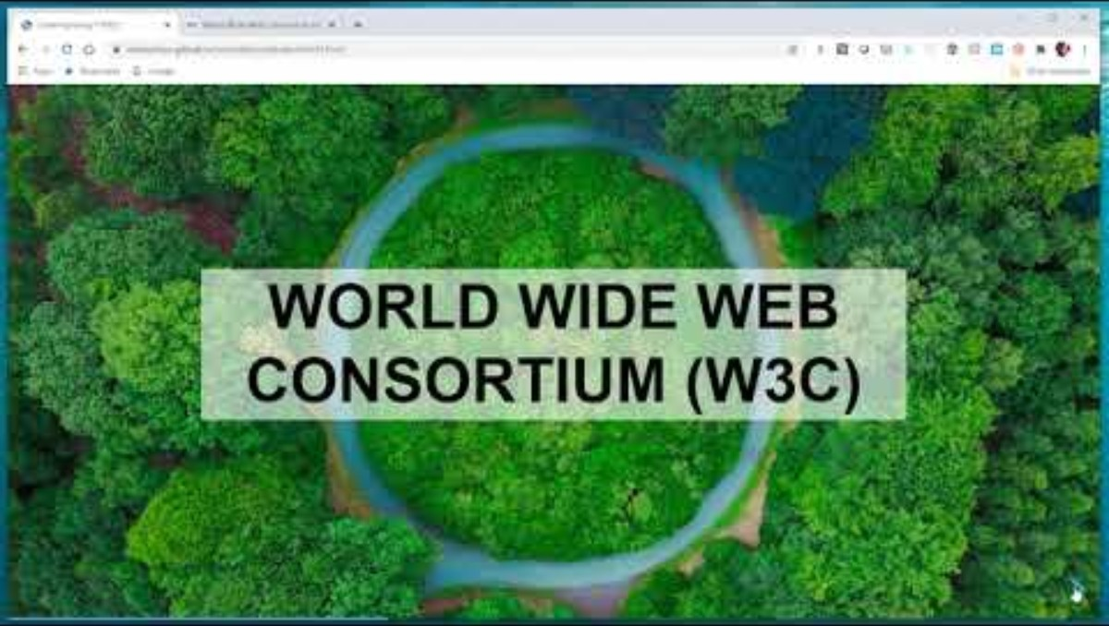
W3C Standards
Technical standards for web development established by the World Wide Web Consortium.
Intent: To promote interoperability, accessibility, and best practices on the web.
Key Features:
HTML, CSS, JavaScript specifications
Accessibility standards (WCAG)
API and performance guidelines
https://www.w3.org/
Notes:
https://www.w3.org/

Slide 16

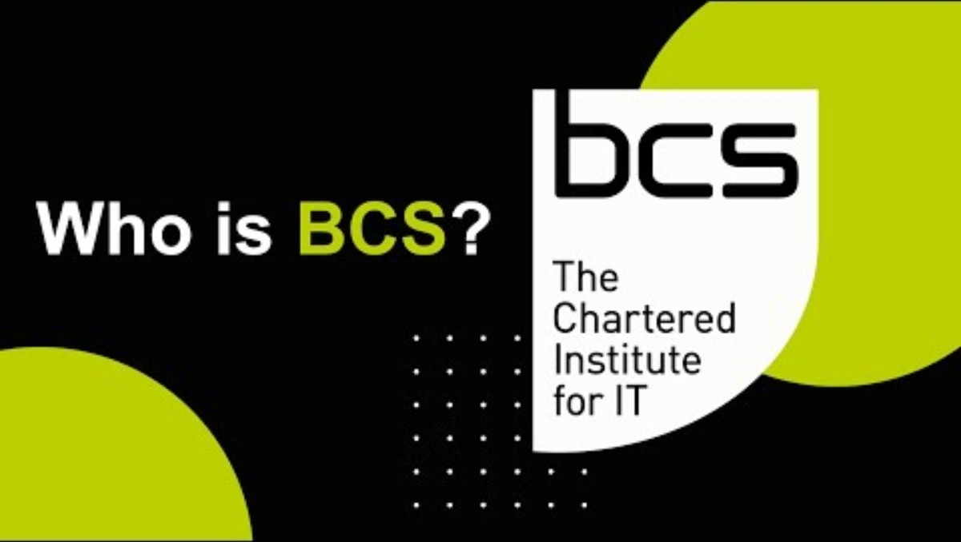
Professional Practice
Maintaining high standards of knowledge, skills, and behaviour in software roles.
Intent: To ensure developers act responsibly and are competent in their field.
Key Features:
Continuous learning and certification
Acting within areas of expertise
Transparent communication with stakeholders
Notes:
https://ieeecsbdc.org/
https://en.wikipedia.org/wiki/British_Computer_Society
https://www.bcs.org/membership-and-registrations/become-a-member/

Slide 17

Codes of Conduct
Ethical guidelines for professional behaviour in software development.
Intent: To promote accountability, respect, and professionalism.
Key Features:
Integrity, honesty, and fairness
Respect for privacy and intellectual property
Examples: ACM, BCS, IEEE codes.
Professional Organisation Code of Conduct:
https://www.bcs.org/media/2211/bcs-code-of-conduct.pdf
https://www.ieee.org/content/dam/ieee-org/ieee/web/org/about/ieee_code_of_conduct.pdf
https://www.acm.org/code-of-ethics
Notes:
https://www.bcs.org/media/2211/bcs-code-of-conduct.pdf
https://www.ieee.org/content/dam/ieee-org/ieee/web/org/about/ieee_code_of_conduct.pdf
https://www.acm.org/code-of-ethics

Slide 18
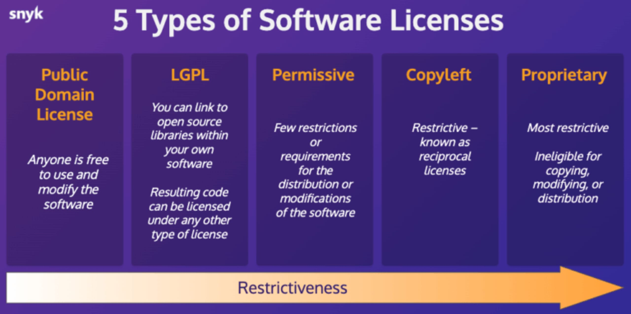
Software Licensing
Ensuring software and tools are used in accordance with their licensing agreements.
Intent: To respect authors' rights and prevent legal issues or unethical reuse.
Key Features:
Compliance with open-source licenses
Avoiding unlicensed software use
Attribution and redistribution rules
Notes:
https://easydigitaldownloads.com/downloads/software-licensing/
https://snyk.io/articles/navigating-software-license/

Slide 19

Inclusion and Diversity in Software
Designing and developing software that reflects and serves a diverse user base.
Intent: To eliminate bias and promote equity in user experience and team collaboration.
Key Features:
Multilingual and culturally adaptive UI
Diverse testing groups
Fair AI and algorithm design
Notes:
https://www.linkedin.com/pulse/building-diverse-inclusive-software-development-team-verbatltd-4yxsc
https://resources.scrumalliance.org/Article/what-agile-software-development-can-teach-us-about-diversity-and-inclusion

Slide 20
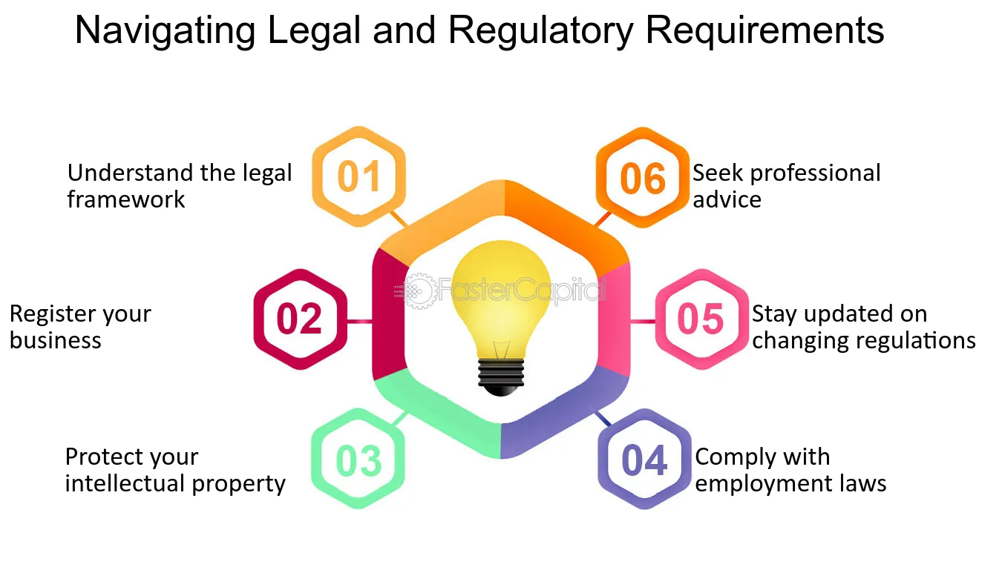
Activity - Legal and Regulatory Requirements in Software Development
Working in teams to explore the rules that govern how software is made, sold, and used.
Goal: Explore and present key legal and regulatory requirements that apply to software development in a specific market (UK, US, EU, or global).
Tasks
Each member takes one core area:
Legal & Licensing
Consumer & Market Compliance
Security & Ethical Practices
Deliverables
A brief presentation (3–5 slides) or handout summary
Explanation of the legal and regulatory points for your assigned area
Real-world examples (where possible)
Notes:
45–60 minutes total (30 mins research, 15 mins prepare summary, 5–10 mins present)

